Slide 1
Pre-Capstone: Diamonds Data
Group 14: Nathan Wyman, Rachel Hollis, Hannah Wolken
Github Project: https://github.com/HannahTAMU/ANYL-605-Pre-Capstone-Project
Notes:
https://github.com/HannahTAMU/ANYL-605-Pre-Capstone-Project

Slide 2
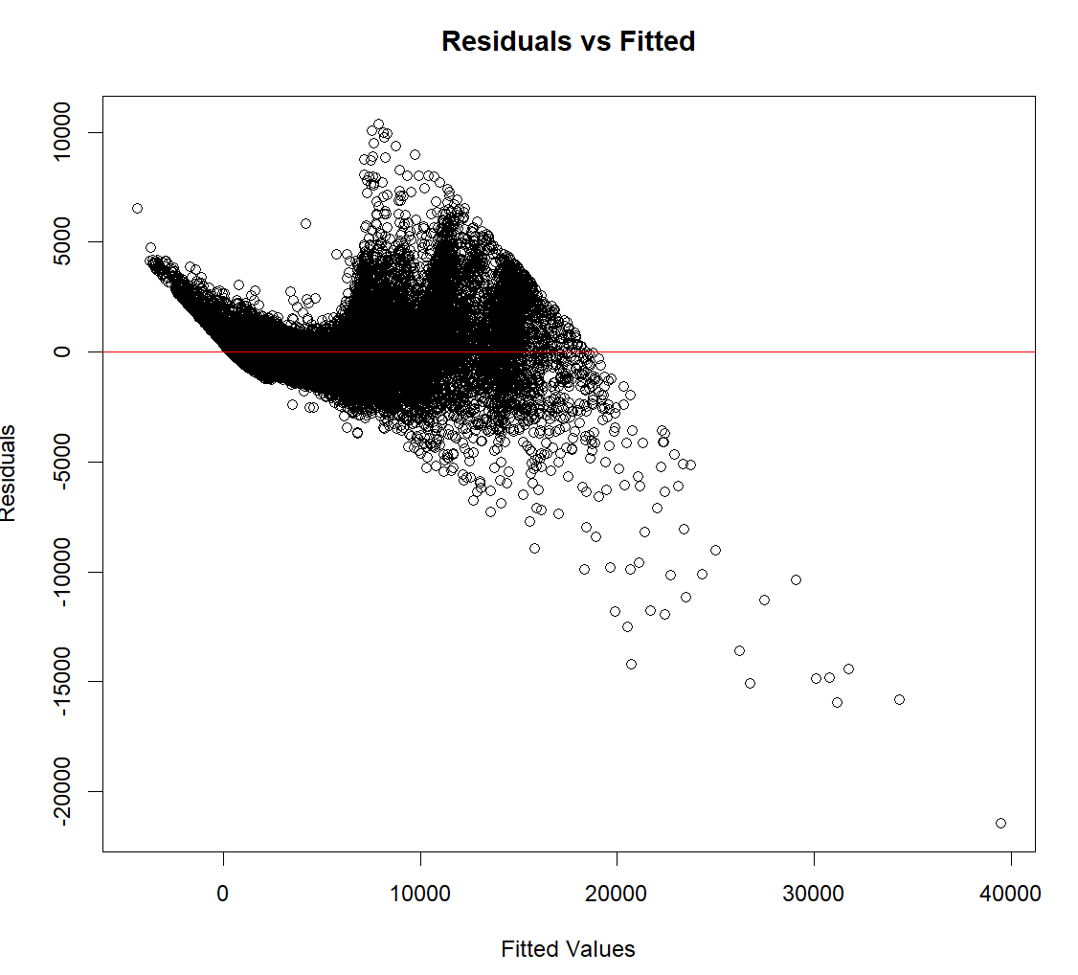
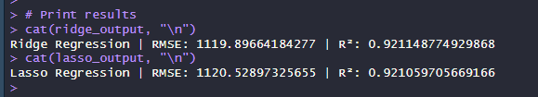
Introduction & Methodology
Problem: Soft Diamond Inc. is a global diamond merchant that would like to analyze how to optimize pricing
Methodology
Attempted Models:
Linear Regression
Lasso
Ridge
After comparing performances, the ridge regression model was chosen
Methodology Challenges
Heteroscedasticity
despite applying various corrective techniques, including weighted least squares, log transformations, and ridge regression with quadratic terms
Notes:
Carrat, length_mm, width_mm, and depth_mm are all highly correlated as carat is a product of the dimensions.
Running a Linear Regression model showed high VIF values for these variables indicating multicollinearity.
Ridge Model chosen because of lowest RMSE value with highest R^2.
Heteroscedasticity persists despite applying multiple corrective techniques, including:
Weighted least squares
Log transformations
Ridge regression with quadratic terms
Most variation occurs at higher price points, where data is sparse.
Higher-priced diamonds may be influenced by factors not included in data, such as:
Brand recognition
Consumer psychology
Purchasing behavior differs across price segments, as high-value diamond buyers may prioritize:
Prestige and exclusivity
Personal or cultural significance
Non-rational cost-benefit considerations
Variance in high-end pricing may be due to these external influences, which are not fully captured in the model.
Model aligns with logical expectations—higher quality diamonds correspond to higher prices.
Analysis remains meaningful and useful despite unresolved heteroscedasticity.

Slide 3
What drives consumers to pay a higher price for a specific piece of diamond?
Carat Weight
Clarity
Larger diamonds command higher prices, although diminishing returns may exist at extreme carat values
Higher Clarity associated with higher prices. I1 < S12 < S11 < VS2 < VS1 < VVS2 < VVS1 < IF (Internally Flawless)
Cut
Higher-rated cuts increase price. The better the cut, the higher the price. Ideal cuts maximize brilliance and attract more consumer demand.
Width
Strong positive influence on price, increasing width will increase price
Color
Premium colors significantly increase price. J < I < H < G < F < E < D
Notes:
Carat weight (+11524.36) is the most influential factor
Cut (base = fair)
Ideal (+772.37) > Premium (+722.41) > Very Good (+650.61) > Good (+514.04)
Diamond Color (base = J (worst))
D (+2353.03) > E (+2152.12) > F (+2099.41) > G (+1893.37) > H (+1392.14) > I (+904.64)
Clarity (base = I1 (worst))
IF (Internally Flawless) (+5252.47) > VVS1 (+4933.09) > VVS2 (+4898.15) > VS1 (+4523.54) > VS2 (+4220.27) > SI1 (+3624.15) > SI2 (+2674.31)
Dimensions Width mm (+1170.97)

Slide 4
Can a specific characteristic of a diamond have a negative impact on consumers’ willingness to pay?
Certain characteristics of a diamond can have a negative impact on consumers' willingness to pay. These include:
Length
Moderate negative influence on price. As length increases by 0.1 mm, price decreases by ~$102.33
Depth
Strong negative influence on price. As depth increases by 0.1mm, price decreases by ~$210.22
Notes:
Length mm (-1023.26)
Depth mm (-2102.15)

Slide 5
What is an optimal combination of carat, length (mm), width (mm), and depth (mm)?
Carat: Sales will increase as carat weight increases towards the optimal value but will decrease as it surpasses the optimal value. The optimal weight is 2.35
2.35 carats
Length (mm): Sales will decrease as length increases to the minimum value but will increase once length surpasses the minimum value of 7.96mm.
Greater than 7.96mm
Width (mm): Sales will decrease as width increases to the minimum value but will increase once width surpasses the minimum value of 2.78mm.
Greater than 2.78mm
Depth (mm): Sales will decrease as depth increases to the minimum value but will increase once depth surpasses the minimum value of 4.27 mm.
Greater than 4.27mm
Notes:
Ran a Ridge Regression model with quadratic terms for Carat, Length mm, Width mm, and Depth mm.
Optimal Value:
Carat (9653.46) and carat^2 (-2045.57)
Minimum Values:
Length_mm (-4380.84) and length_mm^2 (275.24)
Width_mm (-2457.99) and width_mm^2 (442.63)
Depth_mm (-4544.11) and depth_mm^2 (532.33)

Slide 6
The Ideal Diamond
Carat: ~2.4
High Clarity (IF, VVS1, VVS2)
Colorless (D, E, F)
Cut: Premium or Ideal
Depth: greater than 4.27 mm
Length: greater than 7.96 mm
Width: greater than 2.78 mm

Slide 7
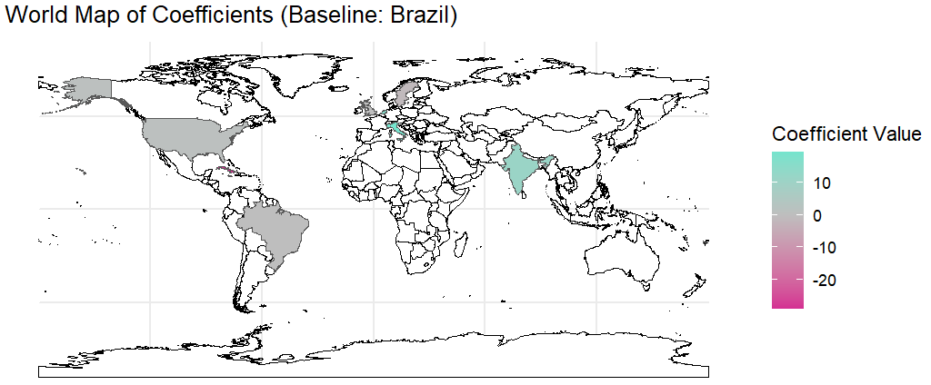
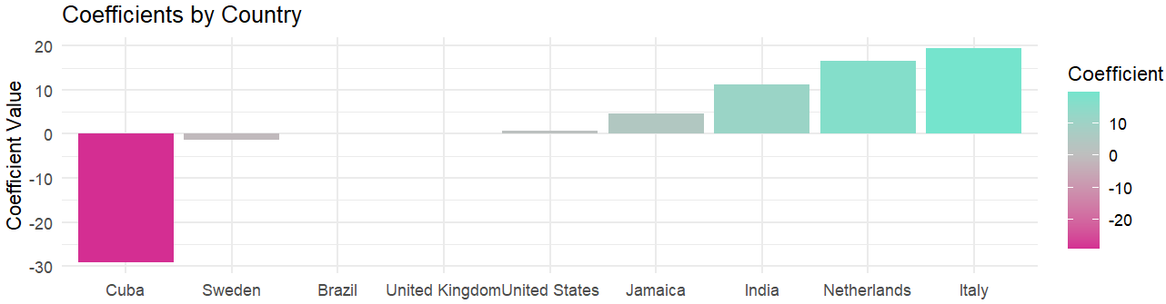
Should they change geographical sourcing decisions?
Model Results: Country Impact on Sales Price
The impact of origin country on price is relatively small. However, some countries have a slight positive impact compared to others.
Colored by coefficient value. Brazil as Baseline
Other factors like sourcing costs, mine reserves, and ethical concerns should be further explored to make a strategic decision
Notes:
Slightly Negative effects compared to Brazil:
Cuba (-29.11)
Sweden (-1.35)
Slight Positive Effects:
India (+11.22)
Italy (+19.39)
Netherlands (+16.59)
Targeting regions with positive coefficients may yield better returns, however this is not a priority.
If we want to make sourcing decisions, we need to different data. Ex: cost of sourcing from specific countries, time it takes to source, ethical concerns

Slide 8
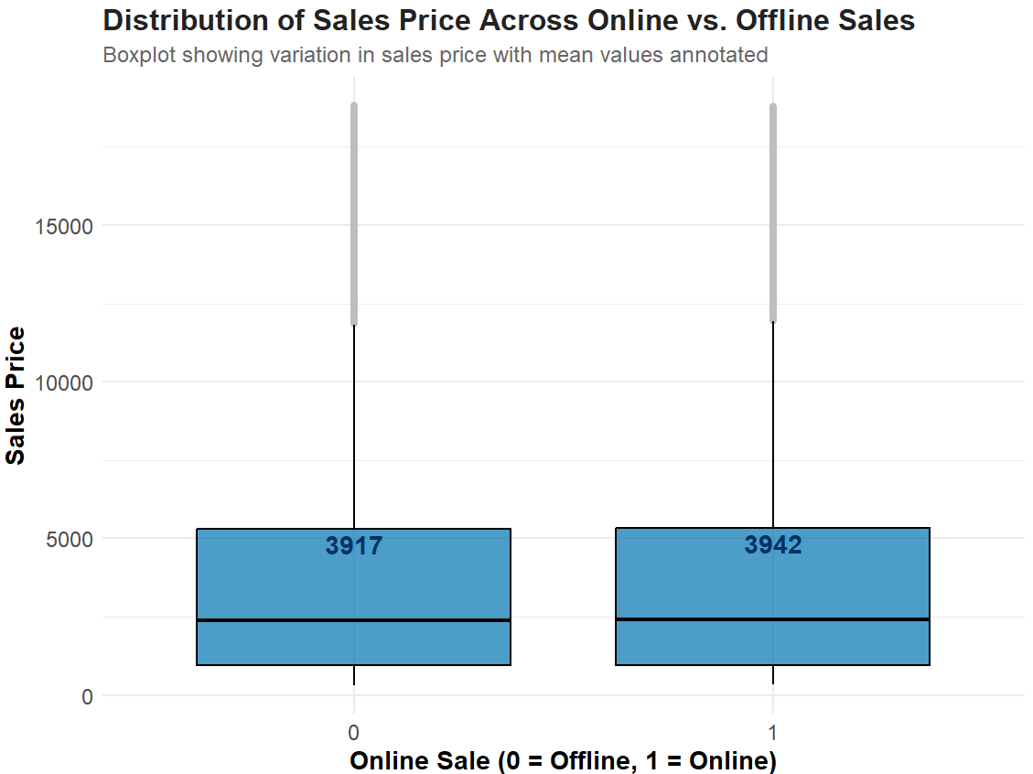
How should they plan for distribution in future?
Enhance digital presence
Online Listings (+3.84) have a slight positive effect that suggests online sales do not hurt pricing.
Be cautious with promotions
Promotional Pricing (-6.97) has a slight negative effect. Careful discounting strategies are needed to avoid undermining profit.

Slide 9
What specific strategies do you suggest such that they can increase the sales?
1) Diamond Dimensions Matter
Optimizing for carat, length, width, and depth can yield higher sales prices & profitable returns
2) Enhance digital presence
Online Listings (+3.84) have a slight positive effect. Digital presence should utilized relative to marketing costs.
3) Source High Quality Colors and Clarity
Color and Clarity can bring in high prices. Source these from pre-existing supply chains like Britain and the Netherlands. Analyze global diamond capacity & costs for strategic long-term sourcing.
4) Focus on Cut Quality
Higher grades of cut can bring high price returns for low cost. Invest in knowledgeable jewelers and technology for best yields.

